Slide 1

Predicting Home Sale Prices in King County, WA
Presented by Sam Oliver

Slide 2
Outline
Business Problem
Data
Methods
Predictive Modeling
Inferences from Model & Conclusions
Further Recommendations

Slide 3

Business Problem
Real estate agency
What characteristics create value in King County?
Identify strategies to build or buy valuable homes.

Slide 4
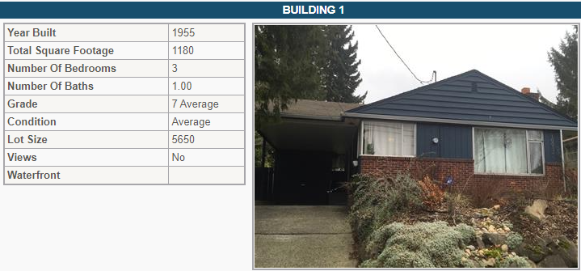
Data
Home sales from 2014-2015
About 21,600 different homes
Variables include: price, #bathrooms/bedrooms, condition, square feet, waterfront, etc.

Slide 5

Methods
Data cleaning
Handle missing or unusual data
Feature engineering
Potential to create new variables with available data
Processing and filtering
Get rid of irrelevant data and extreme datapoints
Linear regression model
Post-model feature selection and repeat steps
Fit formula through datapoints and provide predictive value
Check assumptions and repeat steps as needed

Slide 6
Predictive Modeling
Baseline Model
2 variables: grade & square foot
No transformations, processing, or filtering
Poor performance
Assumptions not met
Final Model
Variables: zip code, waterfront, view, condition, grade, and age of home
Transformations and extreme variable filtering
High performance
Median error of about (+/-) $49k (~11.5%)

Slide 7
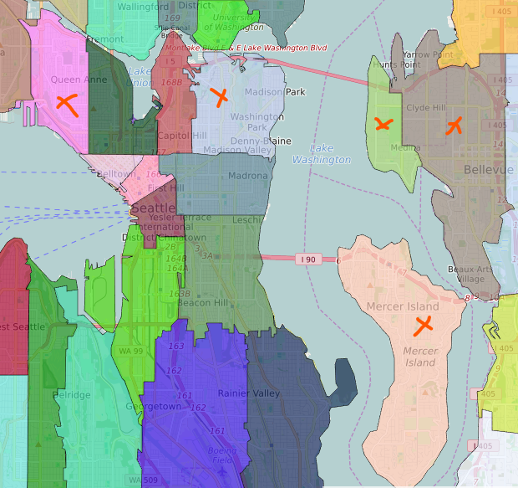
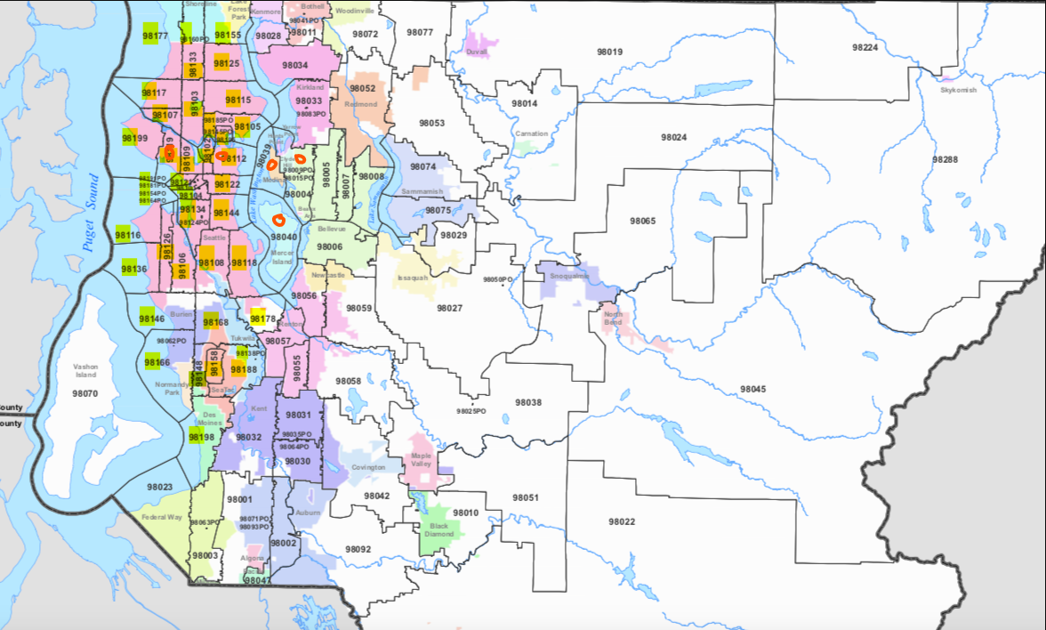
Inferences & Conclusions
Zip codes:
Most influential, value-adding codes:
Medina (98039 ) – 277%, Bellevue (98004) – 210%, Seattle/Washington Park (98112) – 174%, Mercer Island (98040) – 169%, & Seattle (98119) – 161%

Slide 8
Inferences & Conclusions
View – rating of 0-4
General uptrend as view rating increases
Comparative results to view 0:
View 1: +17%
View 2: +16%
View 3: +29%
View 4: +45%
Waterfront
In comparison to a home that is not designated as having a waterfront, homes with a waterfront improve the overall value of a home by 26%

Slide 9
Further Recommendations
Add GIS data
Nearby schools, hospitals, museums, prisons, etc.
Characteristics of people living in various areas or zip codes:
Median salary, education levels, etc.
Job growth and opportunity
Does a certain area have increased home value because people move there for work?
Type of home sale
Bought from a relative
Foreclosures
Private investment firms

Slide 10
Contact Information
Sam Oliver (samueloliver303@gmail.com)
Github Repository: https://github.com/samoliver3/dsc-phase-2-project-v2-3

